Slide 1
Growth Mindset Vs Fixed Mindset

Slide 2
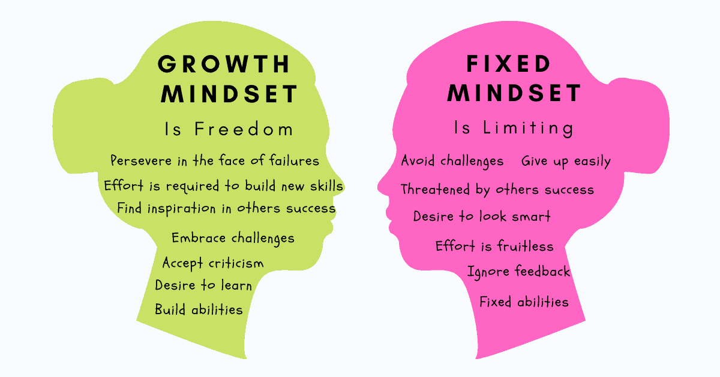

Slide 3

Notes:
The key to what keeps the high achievers and world class performers motivated is determined by their attitude, beliefs, and behaviors. You will need to develop the required self discipline, awareness, and reliance to accomplish your desired result.
People become comfortable with where they are in life because people dont like change or feeling uncomfortable.
To accomplish our dreams we must become the kind of person that it will take to get there.

Slide 4
YOUR OWN MINDSET VOICE
Step 1: Learn to hear your FIXED minset voice
Step 2: Recognise that you have a choice
Step 3: Take back to it with a GROWTH MINDSET voice
Step 4: Take the growth mind action.

Slide 5
QUESTIONS TO ACTIVE A GROWTH MINDSET
What can i learn from this?
Do i know the outcome or goal i’m after?
Where can i get constructive feedback?
If i had a plan to be successfull at [INSERT], what might the plan look like?
When will i follow through on my plan?
What did i learn today?
What mistake did i make that taught me something?
What did i try hard at today?
What habits must i develop to continue the gains i’ve achieved?

Slide 6

JS Core 2
Week 1
Created: 2020-05-06, Last Edited: 2020-05-15 | Authors: Abdoulrazack, Alin, Ahmad | Reviewers: August, Alin, Ahmad.
Notes:
lkkmkm

Slide 7
Objects

Slide 8
By the end of this lesson we should be able to:
1- Define what an object is in JavaScript
2- Be able to write code that can use an object to store data
3- Be able to write code that changes the properties of an object
4- Be able to write code that can retrieve data from an object
5- Write and call methods inside JavaScript objects
6- Use Objects when contained inside an array
7- Write code that uses objects built-in methods
8- Write code that can iterate through an object

Slide 9
Lesson Content
Objects
Objects Get and Set
More About Objects
Object Methods
Arrays of Objects
Objects built-in methods
Loop through an Object

Slide 10
javascript data structures
data structure is a format to organize, manage and store data in a way that allows efficient access and modification.
data structures in javascript
Arrays
Objects
Stacks
Queues
Linked lists
Trees
Binary trees
Graphs

Slide 11
DEMO

Slide 12
1-Definition of an Object
Object: An object is used to store a collection of various data.
An object can be created with {..}, and has properties and methods(which are also called Key: value pair).

Slide 13
1-Definition of an Object
The type of values which can be assigned to a property of an Object are :
Primitive data (String, Number, Boolean, Undefined, Null).
Methods (functions).
Arrays [].
Objects {}.
Notes:
inside an object, we can also have, methods, arrays and other objects.

Slide 14
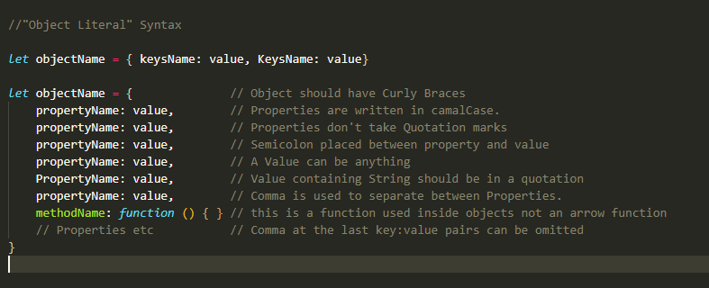
1-Definition of an Object (Object Literal syntax)

Slide 15
1- Object literal Example
Curly braces the object creation
Object name
Variable keyword
Comma to separate between properties.
let laptop = {
brand: “Lenovo”,
screenSize: 13,
isTouchScreen: true
}
Property OR Key
Values

Slide 16
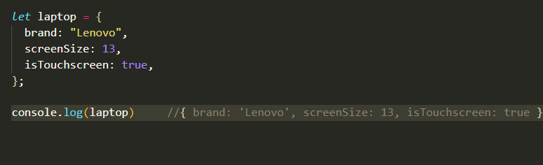
1-Object Example
Laptop has a brand (Lenovo or Apple), a screen size (13 or 15 inch), RAM (8 or 16GB).

Slide 17
Exercises
1, 2, 3, 4
Notes:
20 mins

Slide 18
Accessing an Object’s property

Slide 19
2- Getting a value of an Object’s property
let laptop = {
brand: “Lenovo”,
screenSize: 13,
isTouchScreen: true
}
//Access the value of an Object’s property
console.log(laptop.brand) //Lenovo
console.log(laptop[“brand”]) //Lenovo
console.log(laptop.isTouchScreen) //True
console.log(laptop[“isTouchScreen”]) //True

Slide 20
Adding Or Updating a property’s value

Slide 21
2- Adding a new Object’s property
let laptop = {
brand: “Lenovo”,
screenSize: 13,
isTouchScreen: true
}
laptop.spaceStorage = 15 laptop.spaceStorage = “15 GB”
let laptop = {
brand: “Lenovo”,
screenSize: 13,
isTouchsScreen: true,
spaceStorage: 15
}
New property and its value added

Slide 22
2- Updating a value of an Object’s property
let laptop = {
brand: “Lenovo”,
screenSize: 13,
isTouchScreen: true
}
laptop.brand = “HP” laptop[“brand”] = “HP”
let laptop = {
brand: “HP”,
screenSize: 13,
isTouchsScreen: true,
spaceStorage: 15
}
Brand’s value changed to HP

Slide 23
Demo
(objects 3)

Slide 24
Exercises
(Get and set expecises)
20 mins

Slide 25
3-More about Object

Slide 26
3- More about Object
An object’s property can be assigned a value of a variable like : Primitive data, an Array, or an Object.
We will see example for each ot this.

Slide 27
3- Object’s property assigned to a variable
let screenSize = 50;
let laptop = {
brand: “Lenovo”,
screenSize,
isTouchsScreen: true
}
console.log(laptop.screenSize) //50
Notes:
object is picking up the value of screen size from above. Dont worry about this.

Slide 28
3- Object’s property assigned to an Array
let screenSize = 50;
let laptop = {
brand: “Lenovo”,
screenSize: screenSize,
appInstalled: [“VLC”, “Google Chrome”, “Microsoft App store”],
isTouchsScreen: true
}
console.log(laptop.appInstalled)
//[“VLC”, “Google Chrome”, “Microsoft App store”]

Slide 29
3- Object’s property assigned to an Object
let screenSize = 50;
let laptop = {
brand: “Lenovo”,
screenSize,
appInstalled: [“VLC”, “Google Chrome”, “Microsoft App store”],
isTouchsScreen: true,
deviceSpecifications: { memory: 4, videoGraph: “Intel HD” }
}
console.log(laptop.deviceSpecifications)
//{memory: 4, videoGraph: “Intel HD”}

Slide 30
Demo
(objects3_objects_with_arrays)

Slide 31
Exercises

Slide 32
4- Object Method

Slide 33
4- Object Method
What is a method of an Object ????
A method is a function attached to a particular object. It can reply to another property, can perform some calculation, or change the value of a property.

Slide 34
4- Object Method
Objects in the real world can also do things.
A computer can display something on the screen.
Blog, add blog, update blog, delete blog.

Slide 35
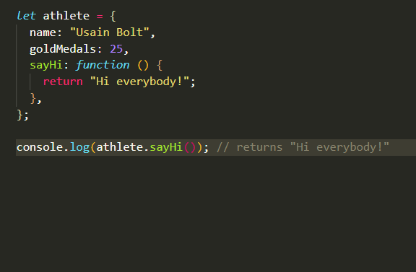
4- Object Method example

Slide 36
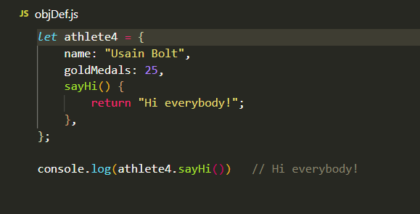
4- Object Method example Short way to write.

Slide 37
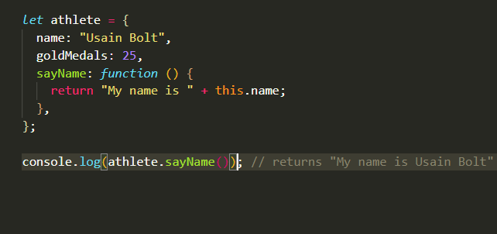
4- Object Method example with Keyword this
This keyword refers to the current Object

Slide 38
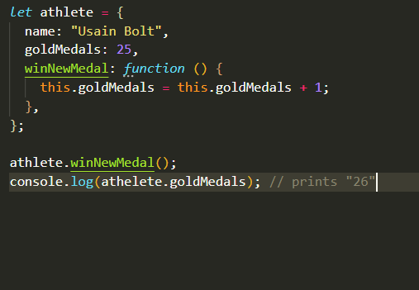
4- Object Method example with incrementation

Slide 39
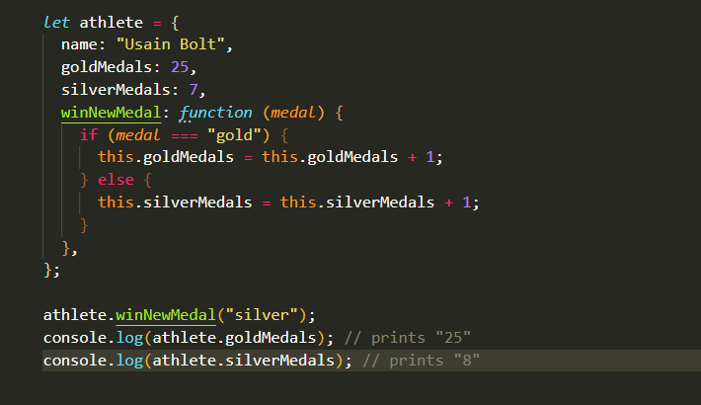
4- Object Method example with conditional statement and parameters.

Slide 40
Demo

Slide 41
Exercises

Slide 42
5- Arrays of Objects

Slide 43
Arrays of objects - benefits
Easier data manipulation - power of array methods
Method chaining = fewer variables
Avoid modifying or mutating the data
Higher-order functions
Closer to daily work - you rarely have a single object
Notes:
1.1 we’ll often favor single expressions over multiple statements. This means we'll greatly reduce the number of variables used and instead utilize method chaining whenever possible.
1.2 One common benefit of using some array methods, such as map and filter, is that they create a new array. By creating new arrays instead of modifying or mutating our original data, our code will be easier to reason about, since mutating data can cause unintended side-effects.
1.3 we'll take advantage of the fact that some of these array methods accept a callback function as a parameter. The callback function allows for code flexibility and readability.

Slide 44
Demo

Slide 45
Exercises
Slack channel document
Read carefully what needs to be done
Write some pseudo-code for each step
Tiny is good
20 minutes

Slide 46
6- Built in methods (static)

Slide 47
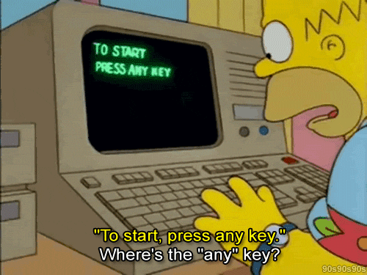
Get keys or values

Slide 48
> How to get the length of a string
Var longestEngWord= “pneumonoultramicroscopicsilicovolcanoconiosis”
>How to round a number
Var yearInDays= 364.25

Slide 49
> How to get the length of a string
Var longestEngWord= “pneumonoultramicroscopicsilicovolcanoconiosis”
>>longestEngWord.length
>How to round a number
Var yearInDays= 364.25
>>Math.round(yearInDays)

Slide 50
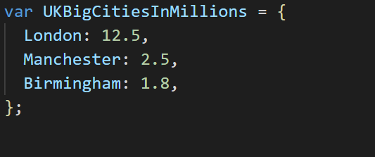
Object.keys(obj)
Take an object as parameter

Slide 51
Object.keys(obj)
Return an array of the keys

Slide 52
Object.values(obj)
Take an object as parameter

Slide 53
Object.values(obj)
Return an array of the values

Slide 54
Demo

Slide 55
Exercises

Slide 56
How I can go through the items of an object?

Slide 57
In Other words.. Loop through them?

Slide 58
Using normal for (let i=0;..) loop?
While?
do/while?
forEach?

Slide 59

How about a new type of loops, just for Objects?

Slide 60
The for/in loop
A.K.A The object loop

Slide 61
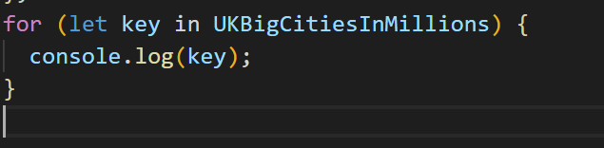
for/in loop
Loops through an object keys

Slide 62
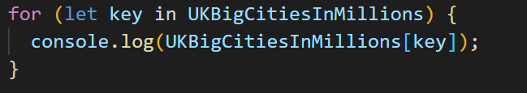
for/in loop
Loops through an object keys, it can return values as well

Slide 63
Demo

Slide 64
Exercises

Slide 65
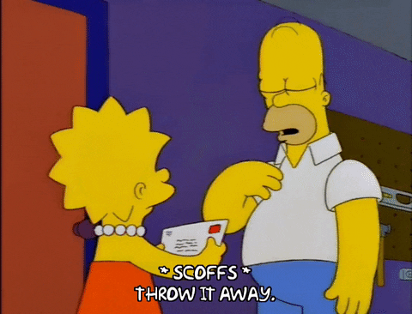
There is a loop called for/of, it’s mainly for arrays

Slide 66

Any questions?

Slide 67
Some Recap?

Slide 68
Feedback form

Slide 69

Homework

Slide 70
1- Homework will be posted through Google classroom
(Google Classroom is the main channel of communication) Sun/Mon
2- Homework will include exercises to do
3- Homework will include resources to read
4- Homework will include a Mandatory call in the channel
5- Ask Questions all week long
There is a virtual IFTAR (Alice)

Slide 71

Enjoy your Holiday
We will miss you

